Slide 1

Inglise keel
„Ajavormid“
Andreas Piiri

Slide 2
Get up!

Slide 3
Keep your feet moving between the questions!

Slide 4
Decide on the tense!

Slide 5


Answer with your elbows!

Slide 6
She was doing the laundry, when the dryer broke.
Past continuous
Future simple

Slide 7
Keep those feet moving!

Slide 8
I will do it later today.
Present simple
Future simple

Slide 9
Have you been watching the show on Netflix?
Present perfect continuous
Present continuous

Slide 10
Has she ever visited Paris?
Present perfect continuous
Present perfect

Slide 11
I hurt my leg, so I sat down.
Past simple
Past perfect

Slide 12
Keep those feet moving!

Slide 13

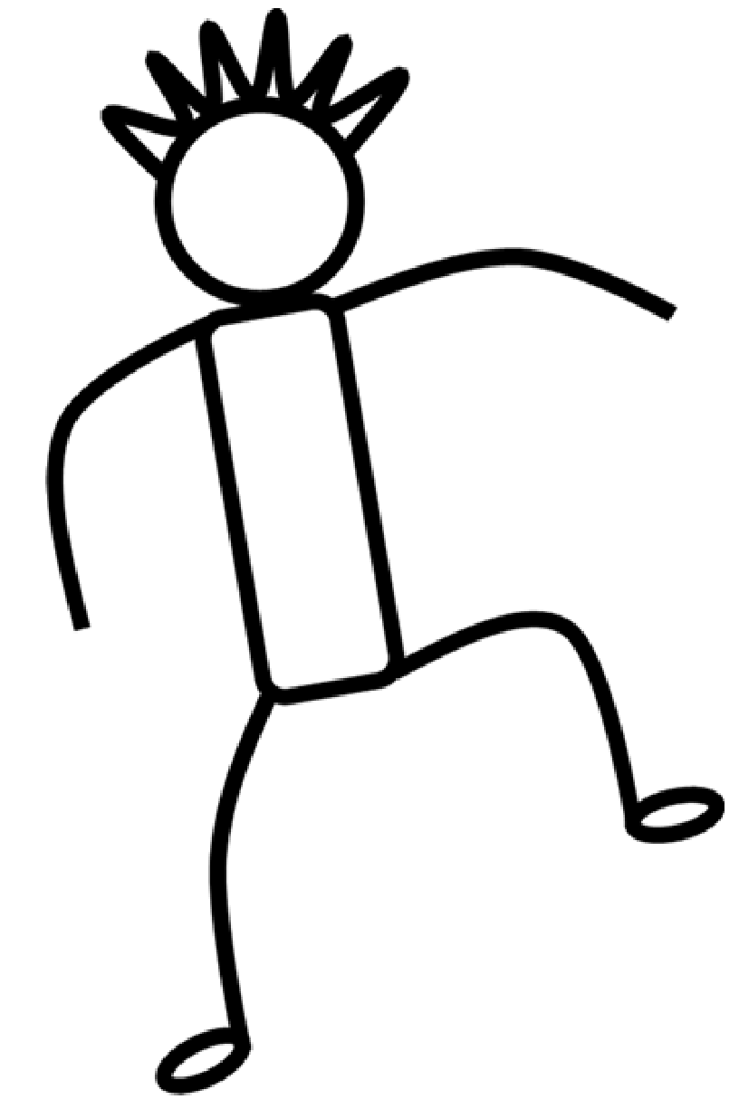
Now answer by raising your leg!
Be careful, there might be a curveball or two!

Slide 14
I’m eating right now, maybe later..
Present continuous
Present simple

Slide 15
She had been to the hospital before.
Present continuous
Past perfect

Slide 16

They had been collecting the data.
Past perfect
Past perfect continuous
Past continuous

Slide 17
Finish by jumping
as high as you can!

Slide 18

That’s the end of our X-Breik!
Hope you had fun!

