Slide 1
ENGLISH
UNIT 9, BODY (YEAR 3)
Karin Sirgmets

Slide 2
BODY PARTS What can you do?

Slide 3
Please stand up!

Slide 4
March in place between each question!

Slide 5

WHAT CAN YOU DO?

Slide 6

Answer like this!

Slide 7
I can touch my left ear with my shoulder.

Slide 8
YES
NO

Slide 9
GOOD JOB!

Slide 10
Keep marching! Are you ready?

Slide 11
I can touch my right knee with my mouth.

Slide 12
YES
NO

Slide 13
WELL DONE! Keep marching!

Slide 14
Now answer like this.

Slide 15
I can cross my fingers.

Slide 16
YES
NO

Slide 17
GREAT! Keep marching!

Slide 18
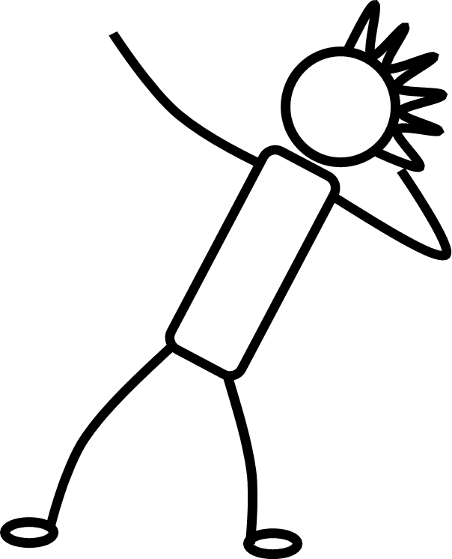
Now answer like this.

Slide 19
I can touch my leg with my nose.

Slide 20
YES
NO

Slide 21
NICE WORK! Keep marching!

Slide 22


Now answer like this.

Slide 23
I can touch my left arm with my right foot.

Slide 24
YES
NO

Slide 25
YOU DID IT!

Slide 26

Thanks!
Bow, please!

